Slide 1
Program Slicer

Slide 2
Program Slicing
Def: A mechanical process of marking all sections of a program text that may influence the value of a variable at a given point in the program.
The tool used to support slicing is known as a program slicer

Slide 3
Importance
Retrieves relevant information irrespective of the size of the program source code.
Helps developer to select and focus on parts of the program that will be affected by a proposed change

Slide 4
Static Code Slicing
A static slice of a program contains all statements that may affect the value of a variable at any point for any arbitrary execution of the program.
Static slices are generally larger.
It considers every possible execution of the program.

Slide 5
Dynamic Code Slicing
A dynamic slice of a program contains all the statements that actually affect the value of a variable at any point for a particular execution of the program.
Dynamic slices are generally smaller.
Considers only a particular execution of the program.

Slide 6
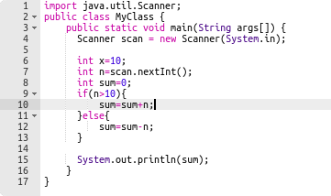
Example

Slide 7
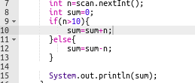

Example
Static Code Slicing for variable Sum
Dynamic Code Slicing for variable Sum

Slide 8
Practical Instructions
IntellijIdea IDE (Ultimate Edition 2021)
For Static Code Slicing:
Right click on a variable or method that is used in a statement
Click Find Usage
Then analyze the variable where it was read from and was altered (value was changed).

Slide 9
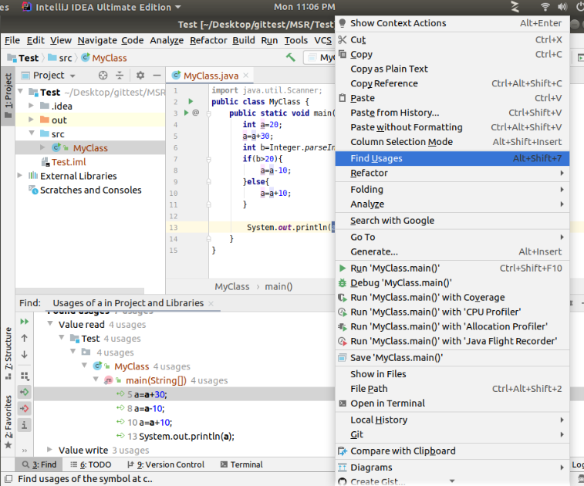

Slide 10
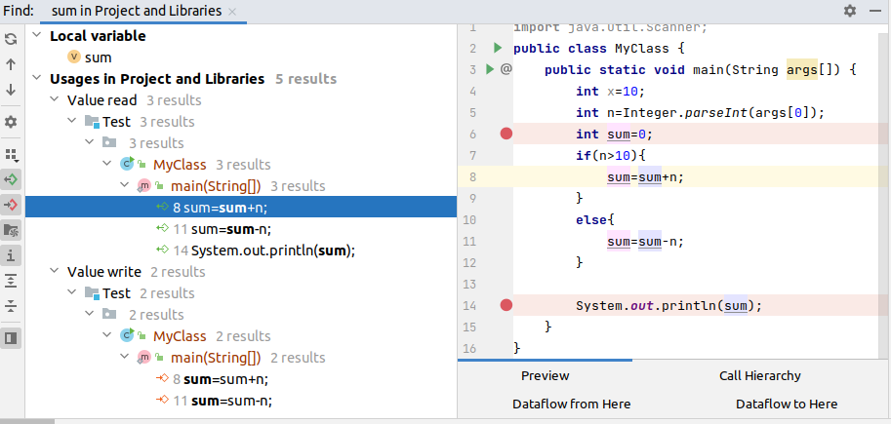
Find Usage
Figure: Static Code Slicing

Slide 11
Notes
Find Usage Feature in IntellijIdea displays all places in code where a variable value was read from or was altered.
It also displays different places in a source code where a particular method was used
Any refactoring or change in method or variable requires analysis of code through static code slicing.

Slide 12
Practical Instructions
IntellijIdea IDE (Ultimate Edition 2021)
For Dynamic Code Slicing:
Right click on a variable or method that is used in a statement
Click Analyze
Then click analyze data flow to here.

Slide 13
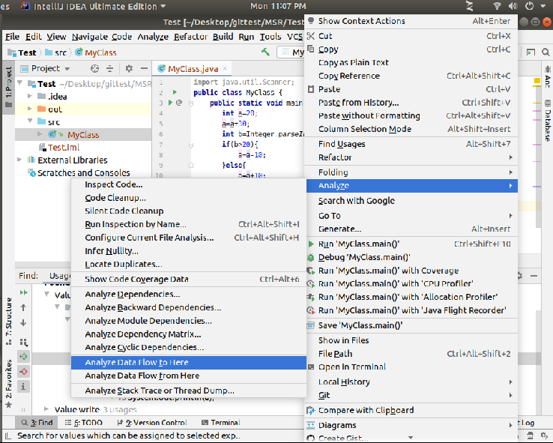

Slide 14
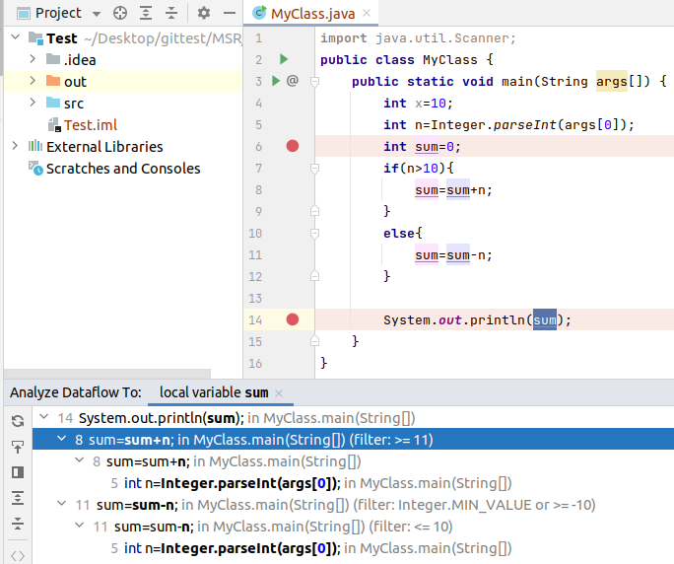
Figure: Dynamic Code Slicing

Slide 15
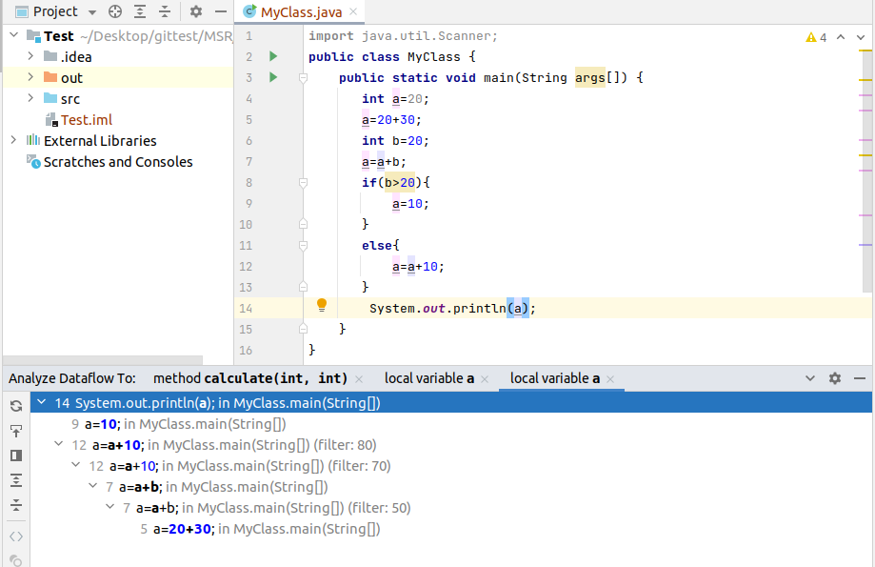
Figure: Dynamic Code Slicing

Slide 16
Notes
It displays all possible executions when the program is in execution mode.
In case of Dynamic code slicing, for different value of data, execution path will change due branching conditions.

Slide 17
Program Slicing Example
http://www0.cs.ucl.ac.uk/staff/m.harman/exe1.html

